Slide 1


Chapter 5
Divide and Conquer
Slides by Kevin Wayne.
Copyright © 2005 Pearson-Addison Wesley.
All rights reserved.

Slide 2
Divide-and-Conquer
Divide-and-conquer.
  Break up problem into several parts.
  Solve each part recursively.
  Combine solutions to sub-problems into overall solution.
Most common usage.
  Break up problem of size n into two equal parts of size ½n.
  Solve two parts recursively.
  Combine two solutions into overall solution in linear time.
Consequence.
  Brute force: n².
  Divide-and-conquer: n log n.

Slide 3
5.1 Mergesort
Notes:
"Divide and conquer", Caesar's other famous quote "I came, I saw, I conquered"
Divide-and-conquer idea dates back to Julius Caesar.
Favorite war tactic was to divide an opposing army in two halves, and then assault one half with his entire force.

Slide 4
Sorting
Sorting. Given n elements, rearrange in ascending order.
Applications.
  Sort a list of names.
  Organize an MP3 library.
  Display Google PageRank results.
  List RSS news items in reverse chronological order.
  Find the median.
  Find the closest pair.
  Binary search in a database.
  Identify statistical outliers.
  Find duplicates in a mailing list.
  Data compression.
  Computer graphics.
  Computational biology.
  Supply chain management.
  Book recommendations on Amazon.
  Load balancing on a parallel computer.
  . . .
obvious applications
problems become easy once items are in sorted order
non-obvious applications
Notes:
Reminder of why sorting is so important.
Once a set of items is sorted, many other problems become easy.
Data compression = burrows wheeler transform.
supply chain management = schedule jobs of varying length to minimize (weighted) completion time
Computer graphics = convex hull, collinear points
particle simulation usually involves sorting N keys in the range 1 to O(N), but might be done for huge inputs - can be N-body simulation (ala Barnes-Hut variant) or for collision detection
Computational biology = longest common substring

Slide 5
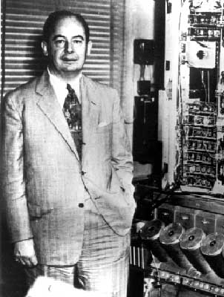
Mergesort
Mergesort.
  Divide array into two halves.
  Recursively sort each half.
  Merge two halves to make sorted whole.
Jon von Neumann (1945)
A
L
G
O
R
I
T
H
M
S
A
L
G
O
R
I
T
H
M
S
divide
O(1)
A
G
L
O
R
H
I
M
S
T
sort
2T(n/2)
A
G
H
I
L
M
O
R
S
T
merge
O(n)

Slide 6
Merging
Merging. Combine two pre-sorted lists into a sorted whole.
How to merge efficiently?
  Linear number of comparisons.
  Use temporary array.
Challenge for the bored. In-place merge. [Kronrud, 1969]
A
G
L
O
R
H
I
M
S
T
A
G
H
I
using only a constant amount of extra storage

Slide 7
Pseudocode
MergeSort (Array(First..Last))
Begin
If Array contains only one element Then
Return Array
Else
Middle= ((Last + First)/2) rounded down to the nearest integer
LeftHalfArray = MergeSort(Array(First..Middle))
RightHalfArray = MergeSort(Array(Middle+1..Last))
ResultArray = Merge(LeftHalfArray, RightHalfArray)
Return ResultArray
EndIf
End MergeSort

Slide 8
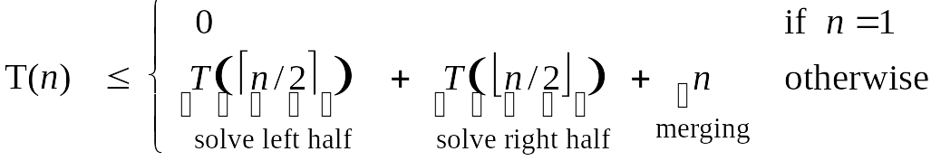
A Useful Recurrence Relation
Def. T(n) = number of comparisons to mergesort an input of size n.
Mergesort recurrence.
Solution. T(n) = O(n log₂ n).
Assorted proofs. We describe several ways to prove this recurrence. Initially we assume n is a power of 2 and replace ≤ with =.

Slide 9
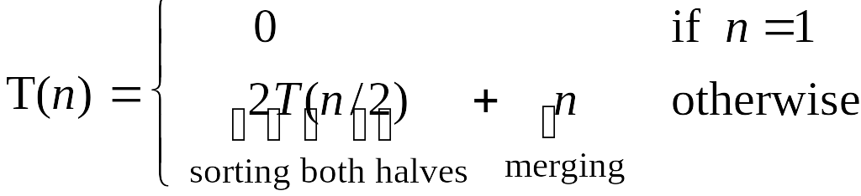
Proof by Recursion Tree
T(n)
n
T(n/2)
T(n/2)
2(n/2)
T(n/4)
T(n/4)
T(n/4)
T(n/4)
4(n/4)
log₂n
. . .
T(n / 2^{k})
2^{k} (n / 2^{k})
. . .
T(2)
T(2)
T(2)
T(2)
T(2)
T(2)
T(2)
T(2)
n/2 (2)
n log₂n

Slide 10
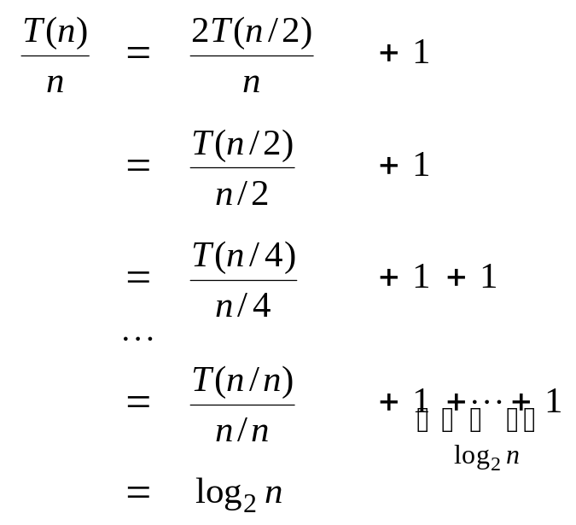
Proof by Telescoping
Claim. If T(n) satisfies this recurrence, then T(n) = n log₂ n.
Pf. For n > 1:
assumes n is a power of 2

Slide 11
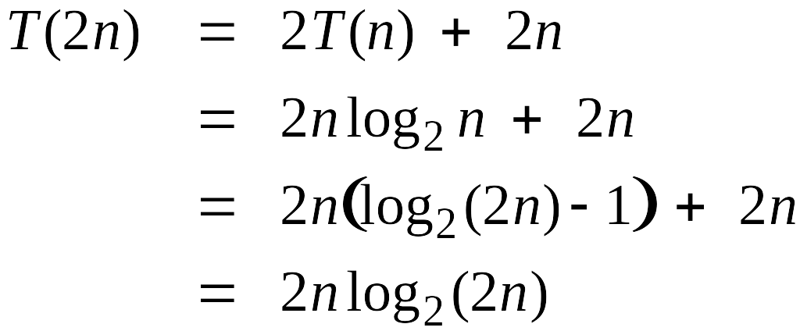
Proof by Induction
Claim. If T(n) satisfies this recurrence, then T(n) = n log₂ n.
Pf. (by induction on n)
  Base case: n = 1.
  Inductive hypothesis: T(n) = n log₂ n.
  Goal: show that T(2n) = 2n log₂ (2n).
assumes n is a power of 2

Slide 12
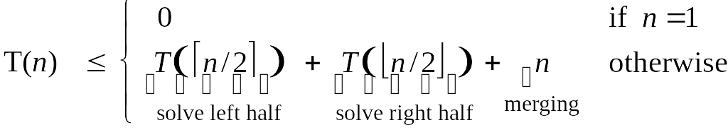
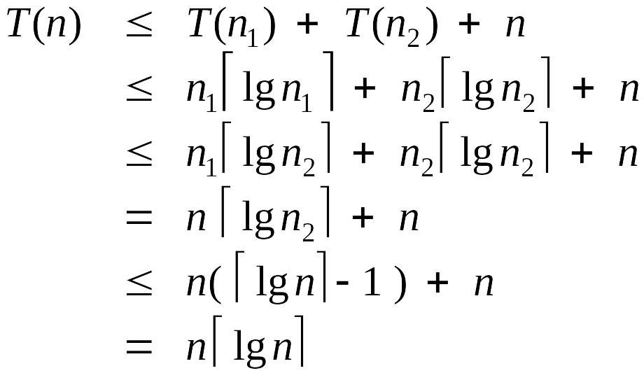
Analysis of Mergesort Recurrence
Claim. If T(n) satisfies the following recurrence, then T(n) ≤ n ⎡lg n⎤.
Pf. (by induction on n)
  Base case: n = 1.
  Define n₁ = ⎣n / 2⎦ , n₂ = ⎡n / 2⎤.
  Induction step: assume true for 1, 2, ... , n–1.
log₂n
??
Notes:
⎡lg n⎤ =< lg n + 1

Slide 13
Recurrence Examples
Some common cases:
•T(n) = T(n – 1) + 1 T(n) is O(n) Linear Search
•T(n) = T(n – 1) + n T(n) is O(n²) QuickSort worst-case
•T(n) = T(n/2) + 1 T(n) is O(log n) Binary Search
•T(n) = T(n/2) + n T(n) is O(n)
•T(n) = 2 T(n/2) + n T(n) is O(n log n) MergeSort
•T(n) = 2 T(n – 1) T(n) is O(2^{n})

Slide 14
5.3 Counting Inversions

Slide 15
Counting Inversions
Music site tries to match your song preferences with others.
  You rank n songs.
  Music site consults database to find people with similar tastes.
  Useful for many social matching, e.g., amazon, netflix, ….
Similarity metric: number of inversions between two rankings.
  My rank: 1, 2, …, n.
  Your rank: a₁, a₂, …, a_{n}.
  Songs i and j inverted if i < j, but a_{i} > a_{j}.
Brute force: check all Θ(n²) pairs i and j.
Songs
A
B
C
D
E
Me
1
2
3
4
5
Inversions
3-2, 4-2
You
1
3
4
2
5
Notes:
amazon.com, launch.com, restaurants, movies, . . .
Note: there can be a quadratic number of inversions.
Asymptotically faster algorithm must compute total number without even looking at each inversion individually.

Slide 16
Applications
Applications.
  Voting theory.
  Collaborative filtering.
  Measuring the "sortedness" of an array.
  Sensitivity analysis of Google's ranking function.
  Rank aggregation for meta-searching on the Web.
  Nonparametric statistics (e.g., Kendall's Tau distance).

Slide 17
Counting Inversions: Divide-and-Conquer
Divide-and-conquer.
1
5
4
8
10
2
6
9
12
11
3
7

Slide 18
Counting Inversions: Divide-and-Conquer
Divide-and-conquer.
  Divide: separate list into two pieces.
1
5
4
8
10
2
6
9
12
11
3
7
Divide: O(1).
1
5
4
8
10
2
6
9
12
11
3
7

Slide 19
Counting Inversions: Divide-and-Conquer
Divide-and-conquer.
  Divide: separate list into two pieces.
  Conquer: recursively count inversions in each half.
1
5
4
8
10
2
6
9
12
11
3
7
Divide: O(1).
1
5
4
8
10
2
6
9
12
11
3
7
Conquer: 2T(n / 2)
5 blue-blue inversions
8 green-green inversions
5-4, 5-2, 4-2, 8-2, 10-2
6-3, 9-3, 9-7, 12-3, 12-7, 12-11, 11-3, 11-7

Slide 20
Counting Inversions: Divide-and-Conquer
Divide-and-conquer.
  Divide: separate list into two pieces.
  Conquer: recursively count inversions in each half.
  Combine: count inversions where a_{i} and a_{j} are in different halves, and return sum of three quantities.
1
5
4
8
10
2
6
9
12
11
3
7
Divide: O(1).
1
5
4
8
10
2
6
9
12
11
3
7
Conquer: 2T(n / 2)
5 blue-blue inversions
8 green-green inversions
9 blue-green inversions
5-3, 4-3, 8-6, 8-3, 8-7, 10-6, 10-9, 10-3, 10-7
Combine: ???
Total = 5 + 8 + 9 = 22.

Slide 21
Counting Inversions: Combine
Combine: count blue-green inversions
  Assume each half is sorted.
  Count inversions where a_{i} and a_{j} are in different halves.
  Merge two sorted halves into sorted whole.
to maintain sorted invariant
3
7
10
14
18
19
2
11
16
17
23
25
6
3
2
2
0
0
13 blue-green inversions: 6 + 3 + 2 + 2 + 0 + 0
Count: O(n)
2
3
7
10
11
14
16
17
18
19
23
25
Merge: O(n)

Slide 22
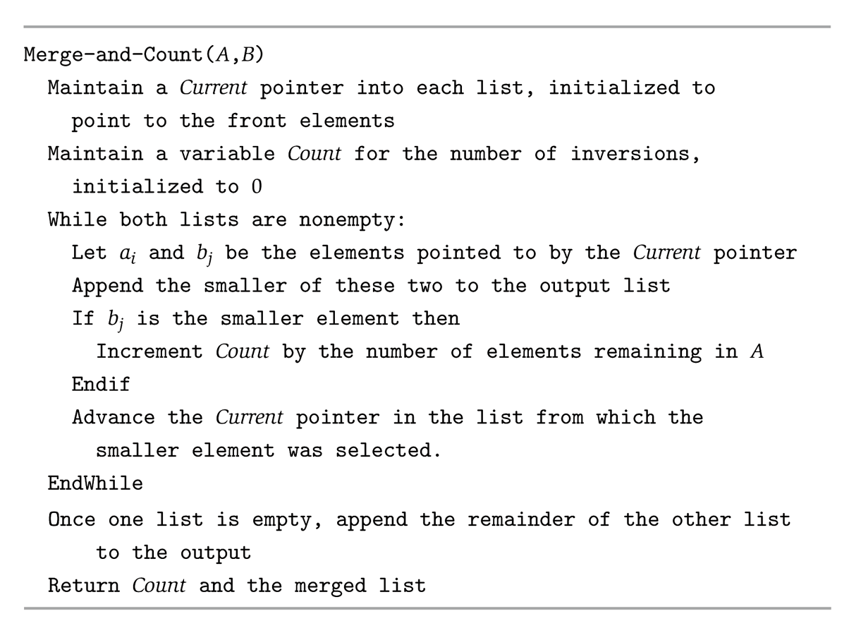

Slide 23
Counting Inversions: Implementation
Pre-condition. [Merge-and-Count] A and B are sorted.
Post-condition. [Sort-and-Count] L is sorted.
Sort-and-Count(L) {
if list L has one element
return 0 and the list L
Divide the list into two halves A and B
(r_{A}, A) ← Sort-and-Count(A)
(r_{B}, B) ← Sort-and-Count(B)
(r_{B}, L) ← Merge-and-Count(A, B)
return r = r_{A} + r_{B} + r and the sorted list L
}

Slide 24
5.4 Closest Pair of Points
Notes:
"Divide and conquer", Caesar's other famous quote "I came, I saw, I conquered"
Divide-and-conquer idea dates back to Julius Caesar.
Favorite war tactic was to divide an opposing army in two halves, and then assault one half with his entire force.

Slide 25
Closest Pair of Points
Closest pair. Given n points in the plane, find a pair with smallest Euclidean distance between them.
Fundamental geometric primitive.
  Graphics, computer vision, geographic information systems, molecular modeling, air traffic control.
  Special case of nearest neighbor, Euclidean MST, Voronoi.
Brute force. Check all pairs of points p and q with Θ(n²) comparisons.
1-D version. O(n log n) easy if points are on a line.
Assumption. No two points have same x coordinate.
fast closest pair inspired fast algorithms for these problems
to make presentation cleaner
Notes:
Foundation of then-fledgling field of computational geometry.
"Shamos and Hoey (1970's) wanted to work out basic computational primitives in computational geometry. Surprisingly challenging to find an efficient algorithm. Shamos and Hoey asked whether it was possible to do better than quadratic. The algorithm we present is essentially their solution."

Slide 26
Closest Pair of Points: First Attempt
Divide. Sub-divide region into 4 quadrants.
L

Slide 27
Closest Pair of Points: First Attempt
Divide. Sub-divide region into 4 quadrants.
Obstacle. Impossible to ensure n/4 points in each piece.
L

Slide 28
Closest Pair of Points
Algorithm.
  Divide: draw vertical line L so that roughly ½n points on each side.
L

Slide 29
Closest Pair of Points
Algorithm.
  Divide: draw vertical line L so that roughly ½n points on each side.
  Conquer: find closest pair in each side recursively.
L
21
12

Slide 30
Closest Pair of Points
Algorithm.
  Divide: draw vertical line L so that roughly ½n points on each side.
  Conquer: find closest pair in each side recursively.
  Combine: find closest pair with one point in each side.
  Return best of 3 solutions.
seems like Θ(n²)
L
8
21
12

Slide 31
Closest Pair of Points
Find closest pair with one point in each side, assuming that distance < δ.
L
21
δ = min(12, 21)
12

Slide 32
Closest Pair of Points
Find closest pair with one point in each side, assuming that distance < δ.
  Observation: only need to consider points within δ of line L.
L
21
δ = min(12, 21)
12
δ

Slide 33
Closest Pair of Points
Find closest pair with one point in each side, assuming that distance < δ.
  Observation: only need to consider points within δ of line L.
  Sort points in 2δ-strip by their y coordinate.
L
7
6
5
21
4
δ = min(12, 21)
12
3
2
1
δ

Slide 34
Closest Pair of Points
Find closest pair with one point in each side, assuming that distance < δ.
  Observation: only need to consider points within δ of line L.
  Sort points in 2δ-strip by their y coordinate.
  Only check distances of those within 11 positions in sorted list!
L
7
6
5
21
4
δ = min(12, 21)
12
3
2
1
δ

Slide 35
Closest Pair of Points
Def. Let s_{i} be the point in the 2δ-strip, with
the i^{th} smallest y-coordinate.
Claim. If |i – j| ≥ 12, then the distance between
s_{i} and s_{j} is at least δ.
Pf.
  No two points lie in same ½δ-by-½δ box.
  Two points at least 2 rows apart
  have distance ≥ 2(½δ). ▪
39
j
31
½δ
2 rows
30
½δ
29
i
28
½δ
27
26
25
δ
δ
Notes:
can reduce neighbors to 6
Note: no points on median line (assumption that no points have same x coordinate ensures that median line can be drawn in this way)

Slide 36
Closest Pair Algorithm
Closest-Pair(p₁, …, p_{n}) {
Compute separation line L such that half the points
are on one side and half on the other side.
δ₁ = Closest-Pair(left half)
δ₂ = Closest-Pair(right half)
δ = min(δ₁, δ₂)
Delete all points further than δ from separation line L
Sort remaining points by y-coordinate.
Scan points in y-order and compare distance between
each point and next 11 neighbors. If any of these
distances is less than δ, update δ.
return δ.
}
O(n log n)
2T(n / 2)
O(n)
O(n log n)
O(n)
Notes:
separation can be done in O(N) using linear time median algorithm

Slide 37
Closest Pair of Points: Analysis
Running time.
Q. Can we achieve O(n log n)?
A. Yes. Don't sort points in strip from scratch each time.
  Each recursive returns two lists: all points sorted by y coordinate, and all points sorted by x coordinate.
  Sort by merging two pre-sorted lists.

Slide 38
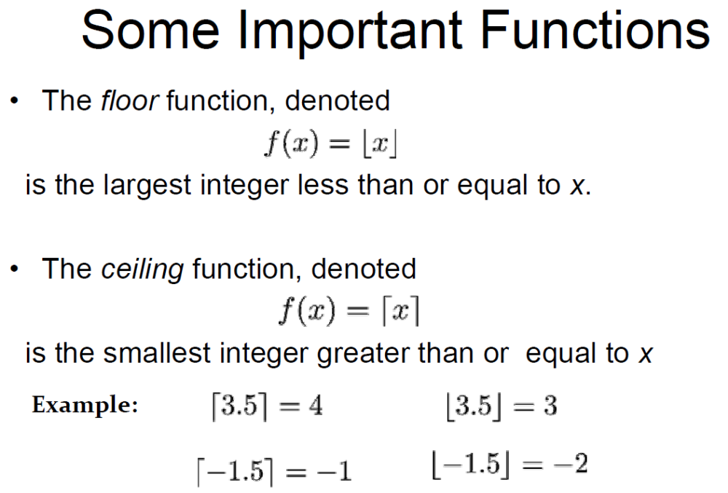

Slide 39
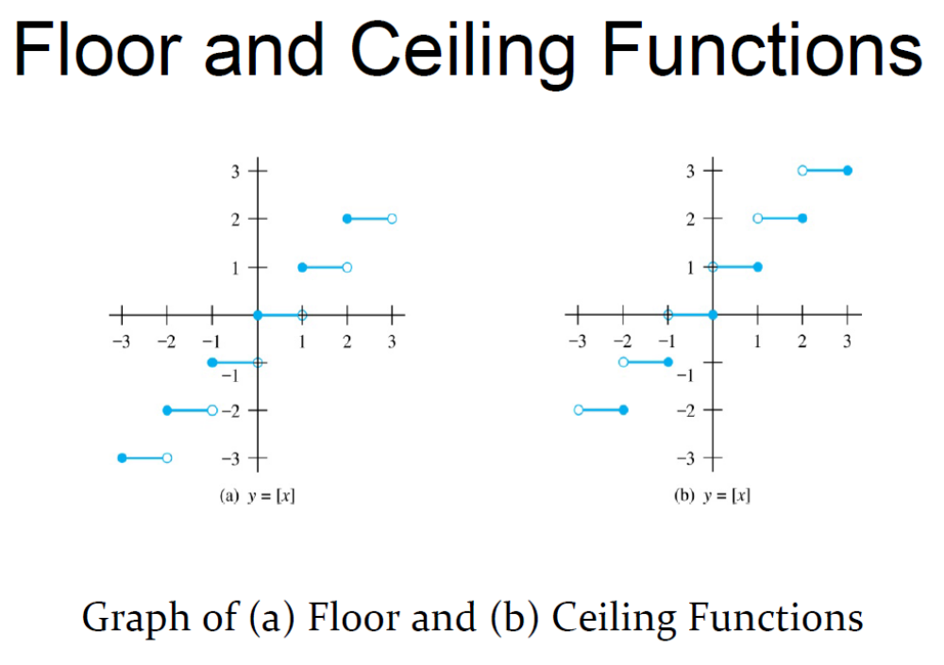

Slide 40
